Slide 1
Implement VTP
LAN Switching and Wireless – Chapter 4

Slide 2
Objectives
Explain the role of VTP in a converged switched network
Describe the operation of VTP: VTP domains, VTP Modes, VTP Advertisements, and VTP Pruning.
Configure VTP on the switches in a converged network.

Slide 3
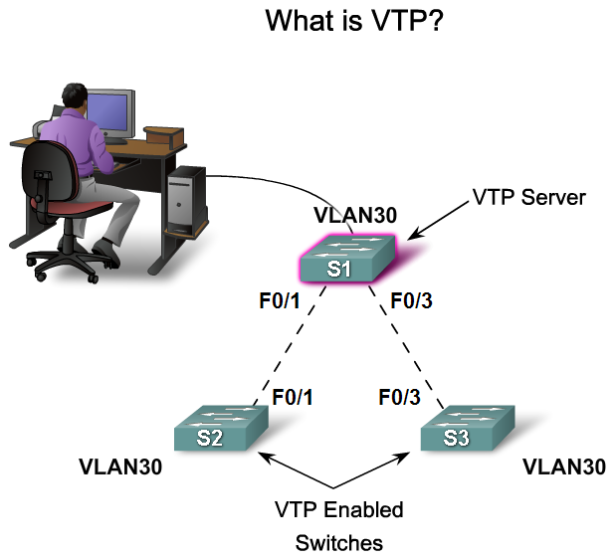
Explain the Role of VTP in a Converged Switched Network
Explain the role of VTP in a multi-switch network

Slide 4
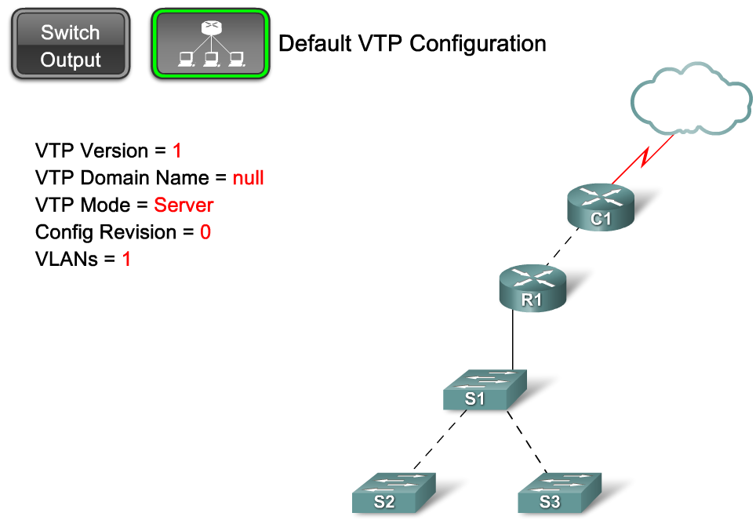
Describe the Operation of VTP
Describe the importance of the default VTP configuration

Slide 5
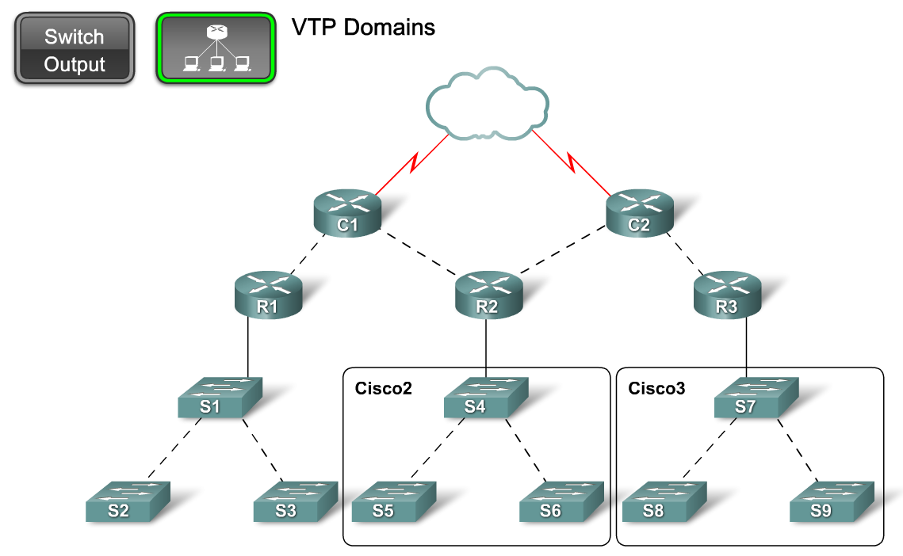
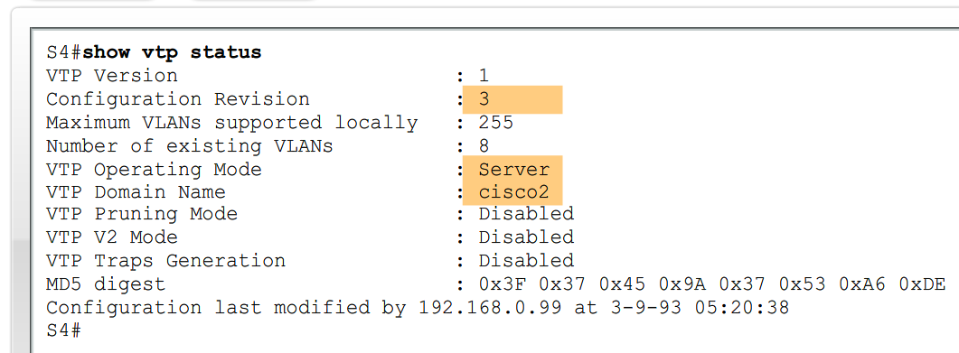
Describe the Operation of VTP
Explain the role of domains in VTP

Slide 6
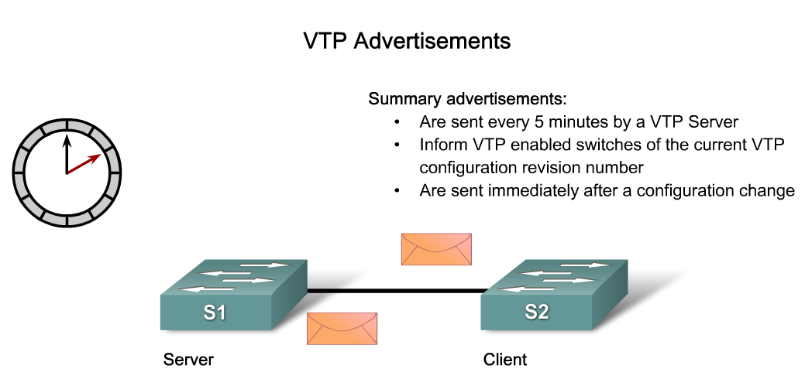
Describe the Operation of VTP
Describe how VTP exchanges domain and VLAN information between switches in the same VTP domain

Slide 7
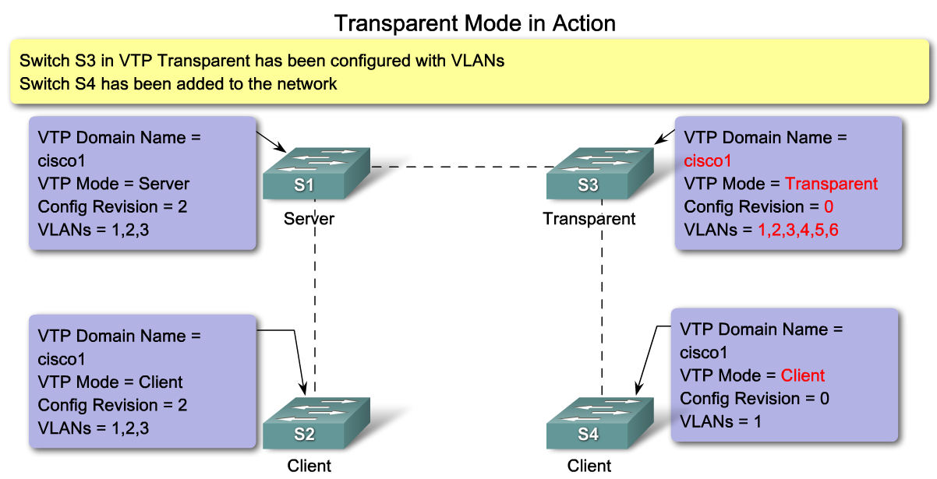
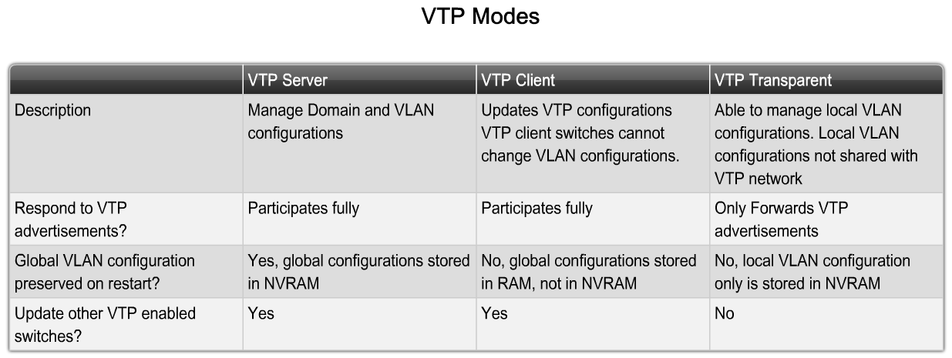
Describe the Operation of VTP
Describe the role VTP modes play in enabling VTP to distribute and synchronize domain and VLAN configuration information in a network

Slide 8
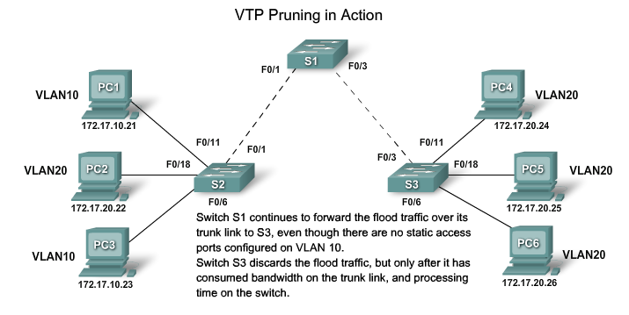
Describe the Operation of VTP
Explain how VTP pruning functions

Slide 9
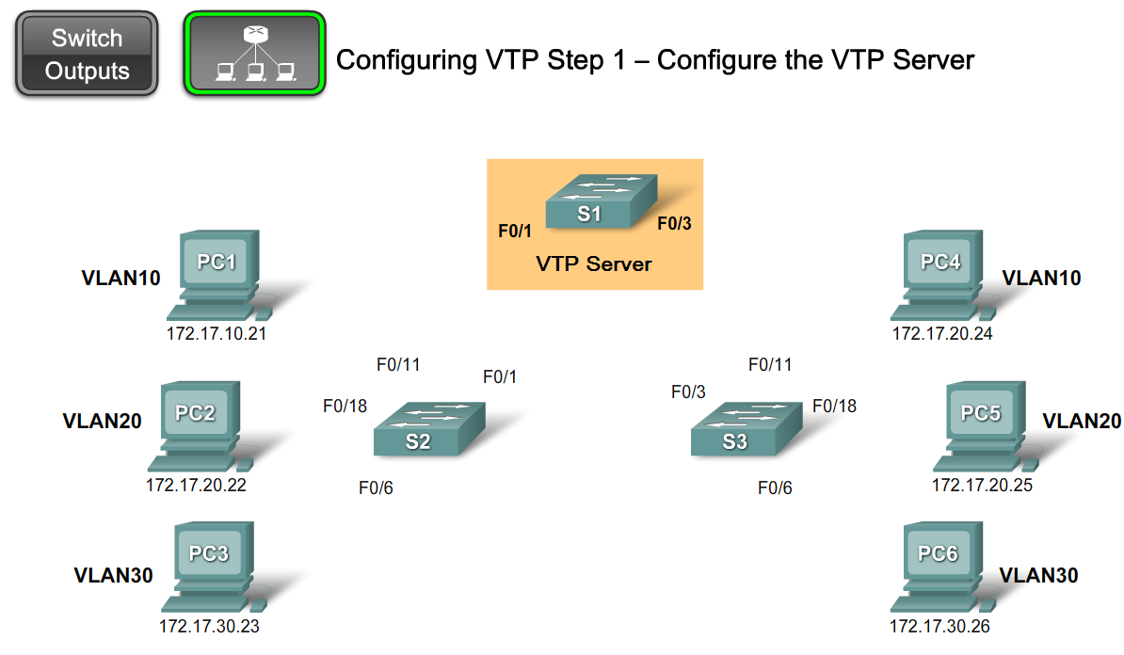
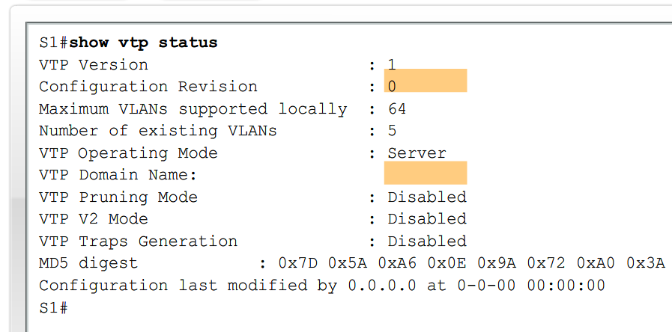
Configure VTP on the Switches in a Converged Network
Configure VTP on a Cisco Catalyst Switch

Slide 10
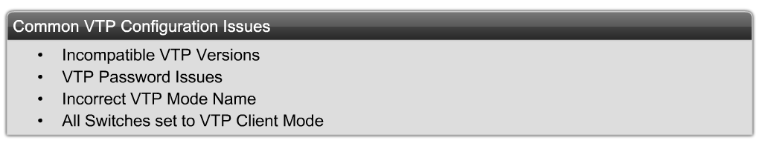
Configure VTP on the Switches in a Converged Network
Identify and troubleshoot common VTP configuration problems

Slide 11
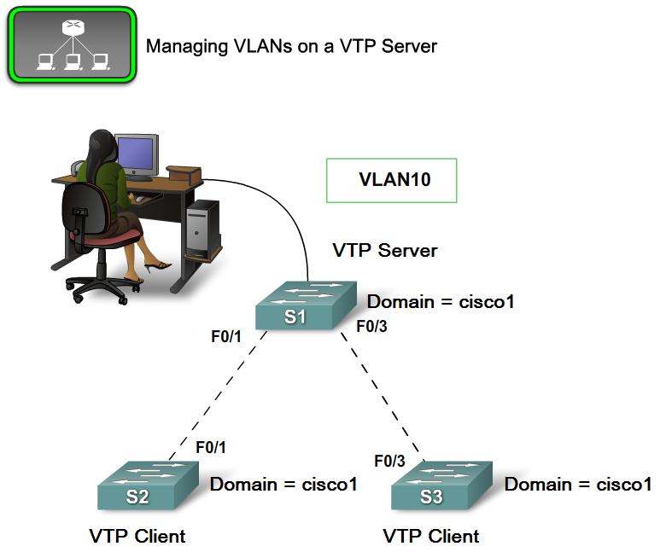
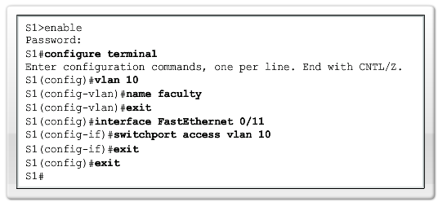
Configure VTP on the Switches in a Converged Network
Manage VLANs on a VTP enabled network

Slide 12
Summary
VTP is a Cisco proprietary protocol used to exchange VLAN information across trunk links.
A switch can be in one of 3 VTP operating modes
  Client
    Cannot create, modify or delete VLAN
  Server
    Can create, modify & delete VLAN
  Transparent
  Can create, modify, & delete LOCAL VLAN
  Forwards VTP advertisements.

Slide 13
Summary
VTP pruning
  Limits unnecessary dissemination of VLAN information.
Verify VTP configuration
  Show VTP status
  Show interfaces trunk

Slide 14
~ANSWERS~

Slide 15
Slide no. 3
*Explain the role of VTP in a multi-switch network*
- VTP or VLAN Trunking Protocol's role in a multi-switch network is to synchronize VLAN information to other VTP-enabled switches so that minimizes the inconsistencies and incorrect configurations.
Slide no. 4
*Describe the importance of the default VTP configuration*
The benefit of VTP is that it automatically distributes and synchronizes domain and VLAN configurations across the network.
Slide no. 5
*Explain the role of domains in VTP*
- VTP allows you to separate your network into smaller management domains to help reduce VLAN management.

Slide 16
Slide no. 6
*Describe how VTP exchanges domain and VLAN information between switches in the same VTP domain *
- For a VTP server or client switch to participate in a VTP-enabled network, it must be a part of the same domain. You will configure vlans in the server switch then the advertisements will send it to the client switch that is part of the domain.
Slide no. 7
*Describe the role VTP modes play in enabling VTP to distribute and synchronize domain and VLAN configuration information in a network *
- Server add, edit, delete vlans, client can request the server to synchronize vlan configurations, and transparent just send any data that pass through it away from the source.
Slide no. 8
*Explain how VTP pruning functions *
-VTP pruning prevents unnecessary flooding of broadcast information from one VLAN across all trunks in a VTP domain.
-Limits unnecessary dissemination of VLAN information.

